Slide 1

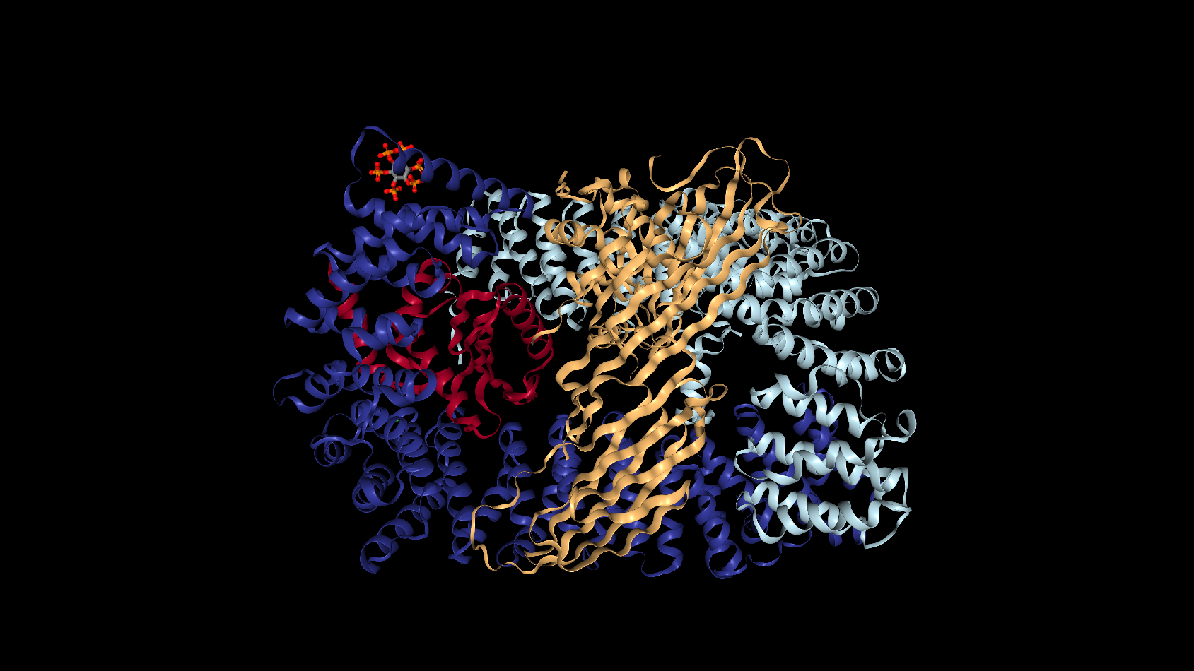
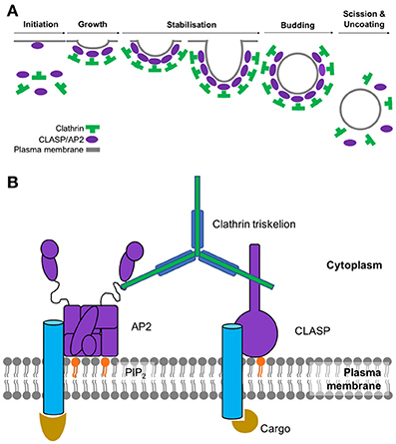
Analysis of Motif Distributions in Regions of Endocytic Proteins
Chante Bethell¹ and Stephanie J. Spielman, PhD²
Department of Molecular and Cellular Biology¹ and Department of Biological Sciences²
Abstract
A short linear motif (SLiM) is a recurring pattern of approximately three to ten amino acids found in proteins. SLiMs are important for cellular signaling and the regulating of proteins, often times by acting as binding sites for protein-binding domains. While SLiMs exist both in ordered regions of proteins where there is a tertiary structure and in disordered regions where there is no structure, they are primarily functional in disordered regions. An important example of SLiM-mediated processes and the focus of this study is endocytosis. Endocytosis is the process by which cells engulf molecules from the extracellular environment. There are specific motifs that mediate and trigger endocytosis. However, the short length of motifs means that it is easy to overlook those that may be important to biological functions. The goal of this study is to identify previously unrecognized proteins that may be involved in endocytosis by analyzing the distribution of motifs in the ordered and disordered regions of the human proteome. Using a bioinformatics approach, we systematically searched the entire human proteome for motifs known to be involved in endocytosis. We hypothesize that the proteins we find to be enriched with motifs in disordered regions may be functionally important for endocytosis. These proteins will be targeted for experimental validation.
Figure 1: The AP2 Protein Adaptor Complex, colored by its subunits: AP2A, AP2B1, AP2S1, AP2M1.¹
Figure 3: This plot shows the CME proteins we chose as controls (the five subunits of AP2 and the associated kinase, AAK1) and their counts of instances in disordered versus ordered regions found across 6 endocytic motifs.
Figure 2A: Steps of the clathrin-coated pit formation.² Figure 2B: The major players in the initiation of CME. The cargo binds to its respective transmembrane receptor, which AP2 then binds to in order to create a bridge to clathrin.²
Conclusion
The results do not support the hypothesis.
The distribution of motifs in the disordered versus ordered regions are not always enriched in endocytotic proteins as displayed in the first plot.
However, enriched proteins across the human proteome that can be targeted for further experimental testing for involvement in endocytosis have been identified.
Many of these identified proteins are not identified in the Eukaryotic Linear Motif (ELM) database, so they are potentially good candidate genes.
YXX[LIMFV]
X[DE]XXXL[LI]
NPXY
[ST]XXXX[LI]
Availability
https://github.com/cbethell/motifs
Bibliography
RCSB Protein Data Bank. (n.d.). 4UQI. Retrieved April 10, 2019, from https://www.rcsb.org/3d-view/4UQI/1
Smith SM, Baker M, Halebian M and Smith CJ (2017) Weak Molecular Interactions in Clathrin-Mediated Endocytosis. Front. Mol. Biosci. 4:72. doi: 10.3389/fmolb.2017.00072
Tidyverse. (n.d.). Retrieved from https://www.tidyverse.org/
UniProt: A worldwide hub of protein knowledge. (2018). Nucleic Acids Research, 47(D1). doi:10.1093/nar/gky1049
The above plots represent heatmaps of proteins organized by their distribution in the disordered and ordered regions for the YXX[LIMFV], X[DE]XXXL[LI], NPXY, and [ST]XXXX[LI] motifs, respectively. Each rectangle is labeled with a number representing the number of proteins that have the same number of instances in the ordered and disordered regions. The rectangles found higher above the green one to one line on each plot represent the proteins that are enriched in the disordered regions.. The plot for the [ST]XXXX[LI] motif differs in that a hexagonal heatmap is used to better visualize the distribution of proteins in the disordered and ordered regions. Similar to the other three plots, each hexagon is labeled with a number representing the number of proteins that have the same number of instances in the ordered and disordered regions, while the green line is a one to one line used to determine which proteins are enriched in the disordered regions and should be targeted based on our hypothesis.
Candidate CME Genes Identified
Protein name⁴ | UNIPROT accession ID | Disordered Protein Count | Ordered Protein Count | Motif | Gene Ontology (GO) terms⁴
Insulin receptor substrate 2 | Q9Y4H2 | 17 | 1 | YXX[LIMFV] | Insulin receptor binding, protein kinase binding, brain development, lipid homeostasis, signal transduction
Insulin receptor substrate 1 | P35568 | 14 | 0 | YXX[LIMFV] | Insulin receptor binding, transmembrane receptor protein tyrosine kinase adaptor activity, glucose homeostasis
Transport protein Sec24B | O95487 | 11 | 2 | YXX[LIMFV] | Coat protein complex II (COPII) vesicle cargo loading, COPII vesicle coating, intracellular protein transport
Protein PRRC2A | P48634 | 10 | 0 | YXX[LIMFV] | RNA binding
Mucin-16 | Q8WXI7 | 10 | 1 | YXX[LIMFV] | Cell adhesion, stimulatory C-type lectin receptor signaling pathway
Trichohyalin | Q07283 | 14 | 1 | X[DE]XXXL[LI] | Calcium ion binding, transition metal ion binding, intermediate filament organization
Uncharacterized protein FLJ40521 | Q8N7P7 | 12 | 0 | X[DE]XXXL[LI] | -
Golgin subfamily A member 6-like protein 4 | A6NEF3 | 11 | 0 | X[DE]XXXL[LI] | Cellular component of the Golgi apparatus
Coiled-coil domain-containing protein 136 | Q96JN2 | 11 | 0 | X[DE]XXXL[LI] | Acrosome assembly, single fertilization, spermatogenesis
Mucin-17 | E7EPM4 | 9 | 0 | X[DE]XXXL[LI] | Cellular homeostasis, O-glycan processing, stimulatory C-type lectin receptor signaling pathway
Receptor protein-tyrosine kinase | E9PFD7 | 3 | 0 | NPXY | ATP binding, transmembrane receptor protein tyrosine kinase signaling pathway
Transmembrane channel-like protein | F5GYU8 | 3 | 0 | NPXY | Integral component of plasma membrane
Calreticulin | K7EJB9 | 3 | 0 | NPXY | Calcium ion binding, unfolded protein binding, protein folding
Calmegin | O14967 | 3 | 0 | NPXY | Calcium ion binding, protein folding chaperone, unfolded protein binding, binding of sperm to zona pellucida
Receptor protein-tyrosine kinase | B4DTR1 | 2 | 0 | NPXY | ATP binding, transmembrane receptor protein tyrosine kinase activity
Mucin-19 | Q7Z5P9 | 119 | 1 | [ST]XXXX[LI] | O-glycan processing, stimulatory C-type lectin receptor signaling pathway
Mucin-17 | E7EPM4 | 114 | 1 | [ST]XXXX[LI] | Cellular homeostasis, O-glycan processing, stimulatory C-type lectin receptor signaling pathway
Mucin-4 | A0A0G2JR46 | 72 | 0 | [ST]XXXX[LI] | Epithelial structure maintenance, regulation of signaling receptor activity
Kruppel-like factor 18 protein | A0A0U1RQI7 | 51 | 1 | [ST]XXXX[LI] | Regulation of transcription by RNA polymerase II, nucleic acid binding
Adenomatous polyposis coli protein | P25054 | 42 | 7 | [ST]XXXX[LI] | Protein kinase regulator activity, cell adhesion, cell migration, cell cycle arrest

